Slide 1



Healthcare data exploration
Introduction to ai

Slide 2

Introduction
Importance of data-driven decision-making in healthcare.
Availability of EHRs and Hospital management systems.
Objectives: Analyzing hospital data to extract meaningful insights.

Slide 3
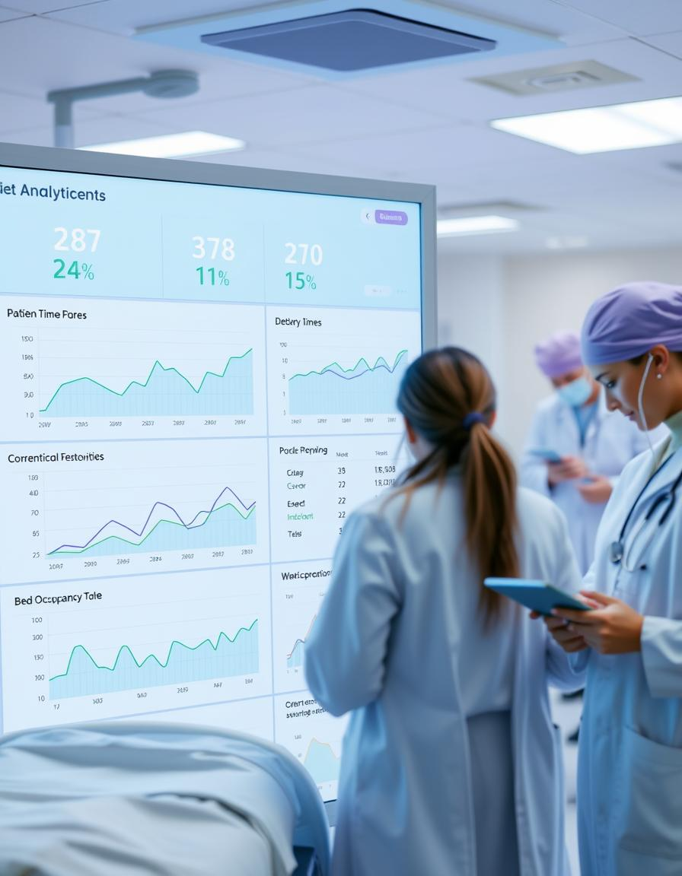
Project Objectives
Perform exploratory data analysis (EDA) on the hospital dataset.
Visualize key trends and relationships.
Analyze the impact of age, gender, and medical history on hospital stay and treatment costs.
Find correlations between treatment costs, length of stay, and patient outcomes.
Provide actionable insights for hospital administrators and healthcare professionals.
Tools: Python ( Matplotlib, Pandas, Seaborn )

Slide 4

Methodology
Step 1: Data Collection (Kaggle Hospital Dataset)
Step 2: Data Preprocessing (Handling Missing Data, Data Type Conversion, Feature Engineering)
Step 3: Exploratory Data Analysis (EDA)
Step 4: Data Visualization
Step 5: Insights & Interpretation

Slide 5

Data Collection
Source: Kaggle’s “Hospital Dataset for Practice”
Format: CSV
Contents: Patient info, medical conditions, treatment details

Slide 6
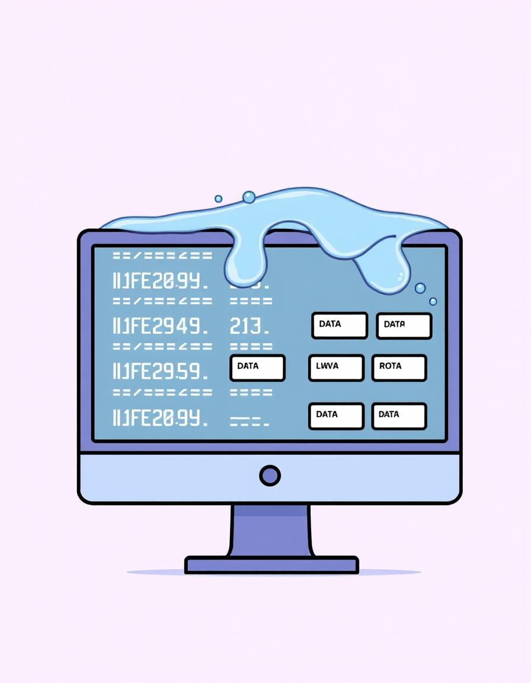
Data Preprocessing
Handling Missing Data:
Numerical: Fill with median (e.g., Cost, Length_of_Stay)
Categorical: Replace with "Unknown" (e.g., Gender, Condition)
Data Type Conversion:
Ensure correct formats for analysis
Feature Engineering:
Created "Age_Group" column (e.g., 0-18, 19-35)

Slide 7

Exploratory Data Analysis (EDA)
Summary Statistics: Mean, median, standard deviation
Demographic Analysis: Age, Gender, Conditions
Hospital Utilization: Length_of_Stay, Readmission, Costs
Outcome Analysis: Conditions vs. patient outcomes

Slide 8

Data Visualization
Bar/Count Plots: Gender, Condition frequency, Readmission
Histograms: Age, Length_of_Stay distribution
Scatter Plots: Cost vs. Length_of_Stay
Heatmaps: Correlations between numerical variables

Slide 9
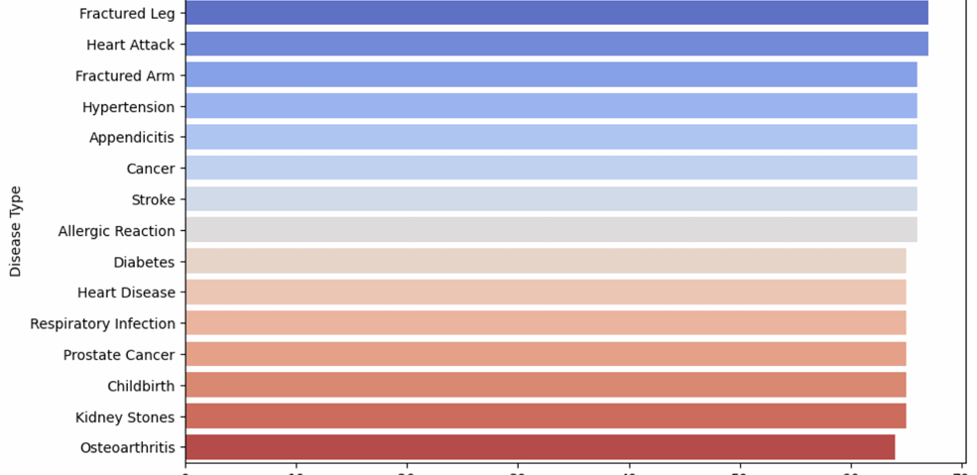
Distribution of disease in patient

Slide 10
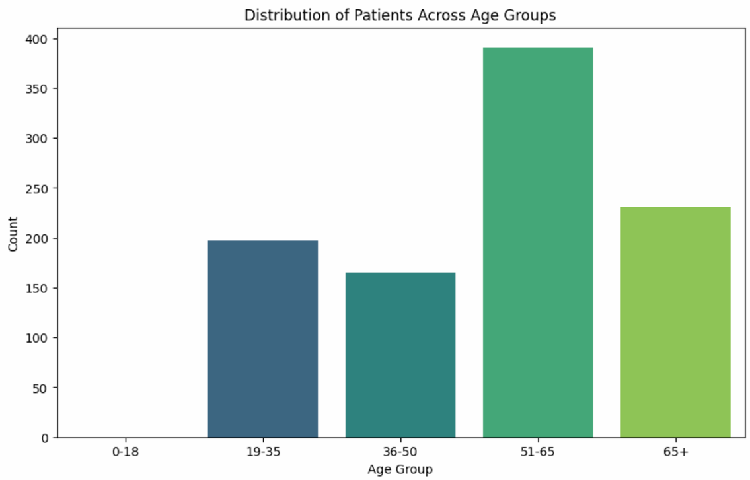
Distribution of patients across age group

Slide 11
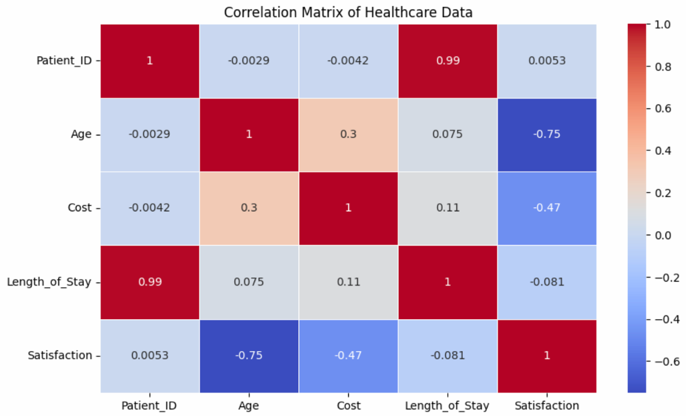
Correlation matrix of healthcare data

Slide 12
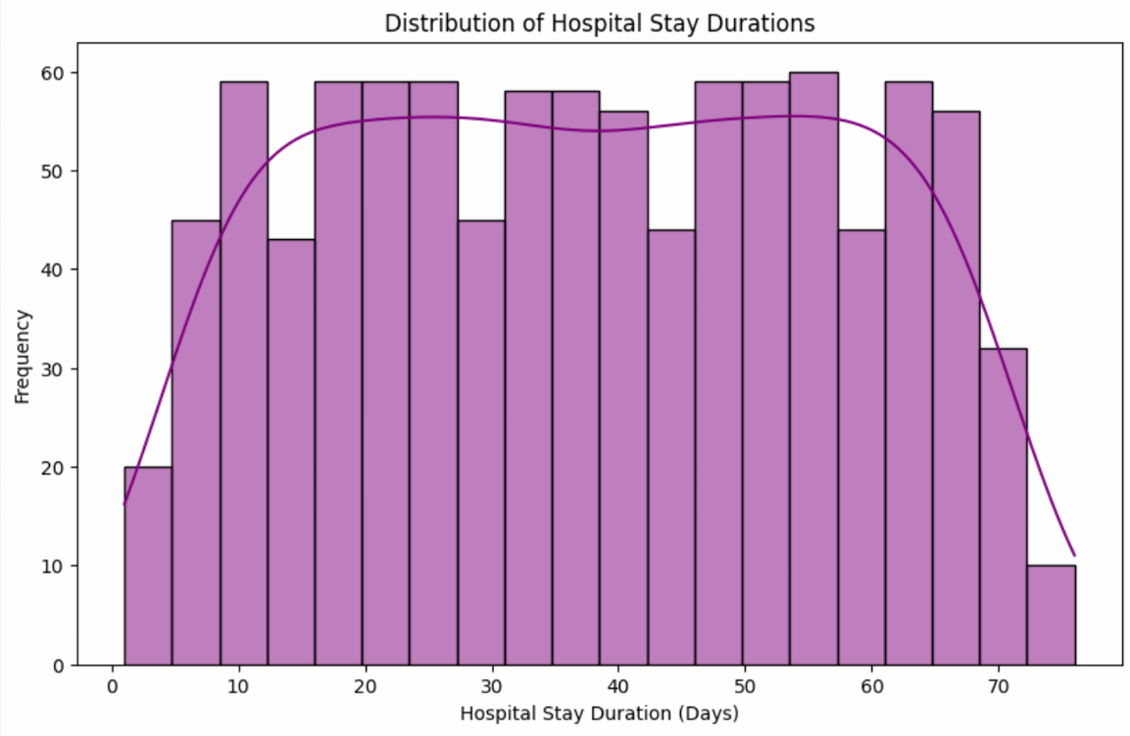
Distribution of hospital stay duration

Slide 13
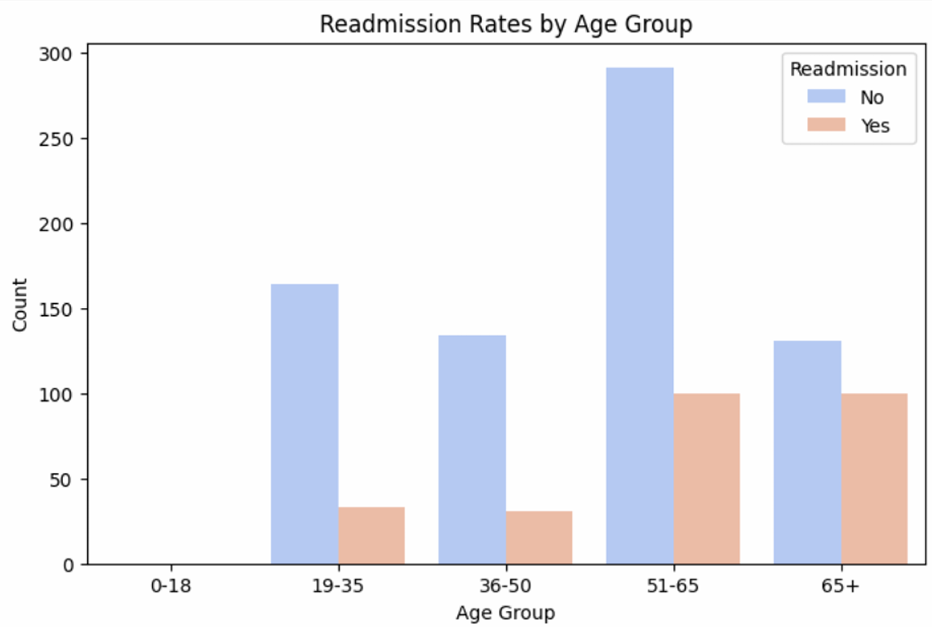
Readmission rates by age group

Slide 14
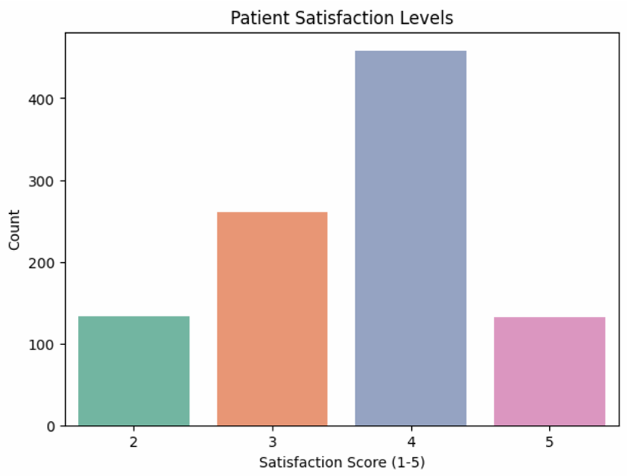
Patient satisfaction levels

Slide 15
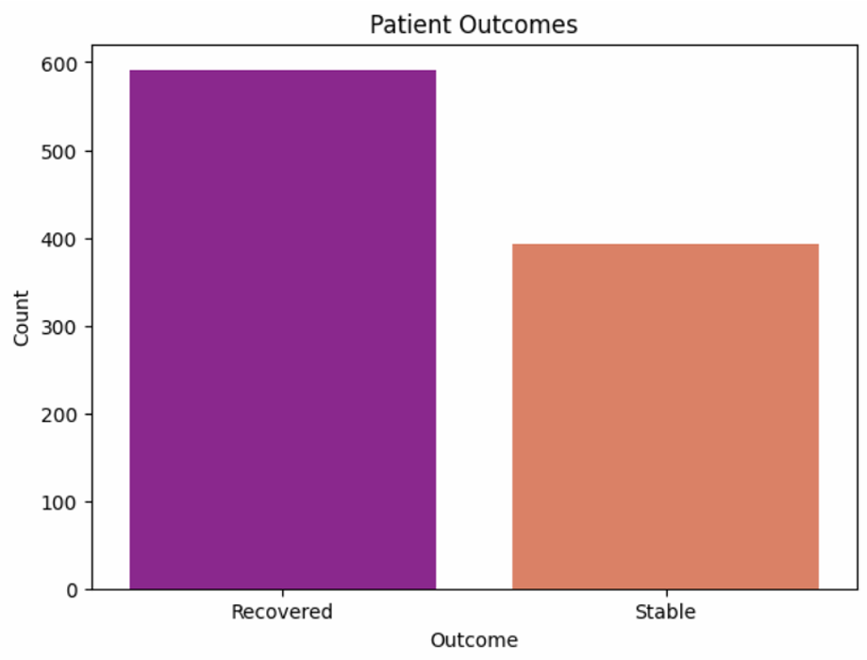
Patient outcome

Slide 16
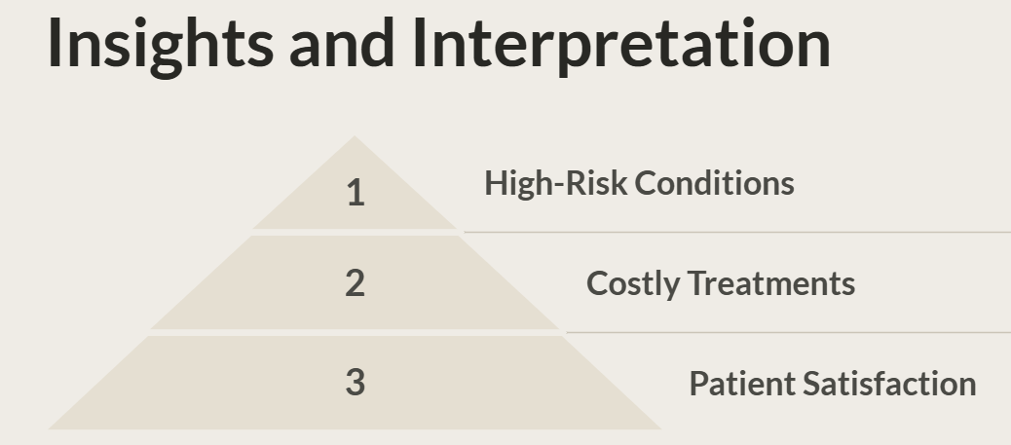
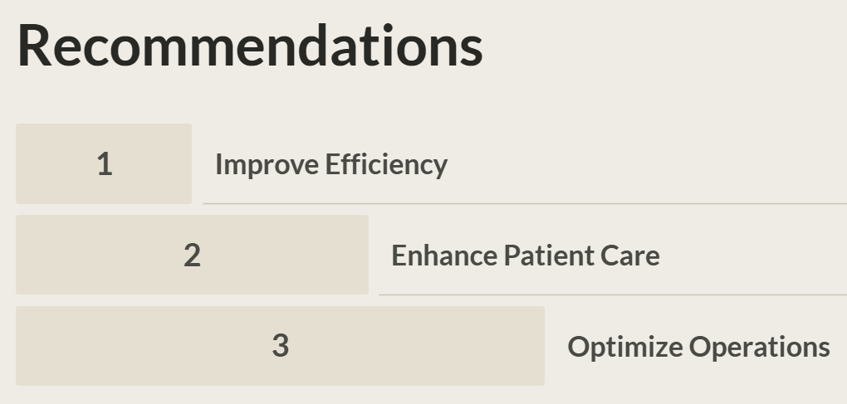
Insights & Interpretation
Identified high-risk conditions and costly treatments.
Observed trends in patient satisfaction and readmission rates.
Recommendations:
Optimize resource allocation for frequent conditions.
Target interventions for high-risk age groups.

Slide 17

Conclusion
Demonstrated the power of EDA and visualization in healthcare.
Provided actionable insights for improving patient care and hospital efficiency.
Future Scope: Predictive modeling for readmission risk or cost estimation.

Slide 18
Thank you

